Slide 1
Keyphrase extraction
and application
Minh Hoang HO
minhhoangho99@gmail.com
15 Oct 2022

Slide 2
Contents
Introduction
Methodology
1
2
Keyphrase extraction and application
Related work and research
Keyphrase extraction
Result
3
4
Architecture and implementation
Evaluation and conclusion

Slide 3
Introduction
1

Slide 4
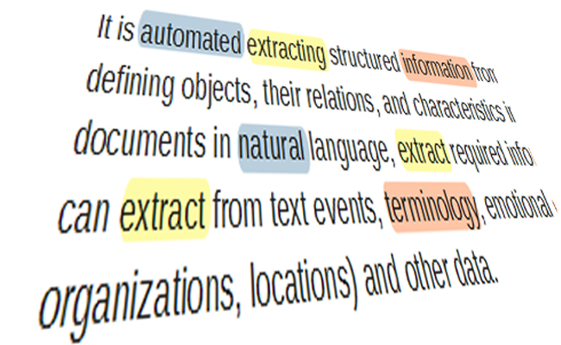

Key phrase extraction and application
Part-of-speech tagging
Named entity recognition
Keyphrase extraction

Slide 5
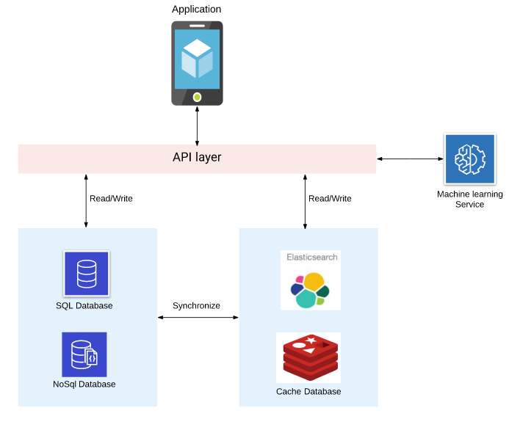
System overview

Slide 6
Methodology
2

Slide 7

Related work
Unsupervised method (TF-IDF, WikiRank, SgRank, TextRank, …)
Self-supervised method
Supervised method

Slide 8
Approach
Keyphrase extraction → Classification problem
https://monkeylearn.com/keyword-extractor-online/
Input document:
d = {w1,w2, ..., wn}
→ Label each word into 3 classes: B-P I-P O-P
Restaurant has a big view of natural landscape
O O O B-P I-P I-P I-P I-P

Slide 9
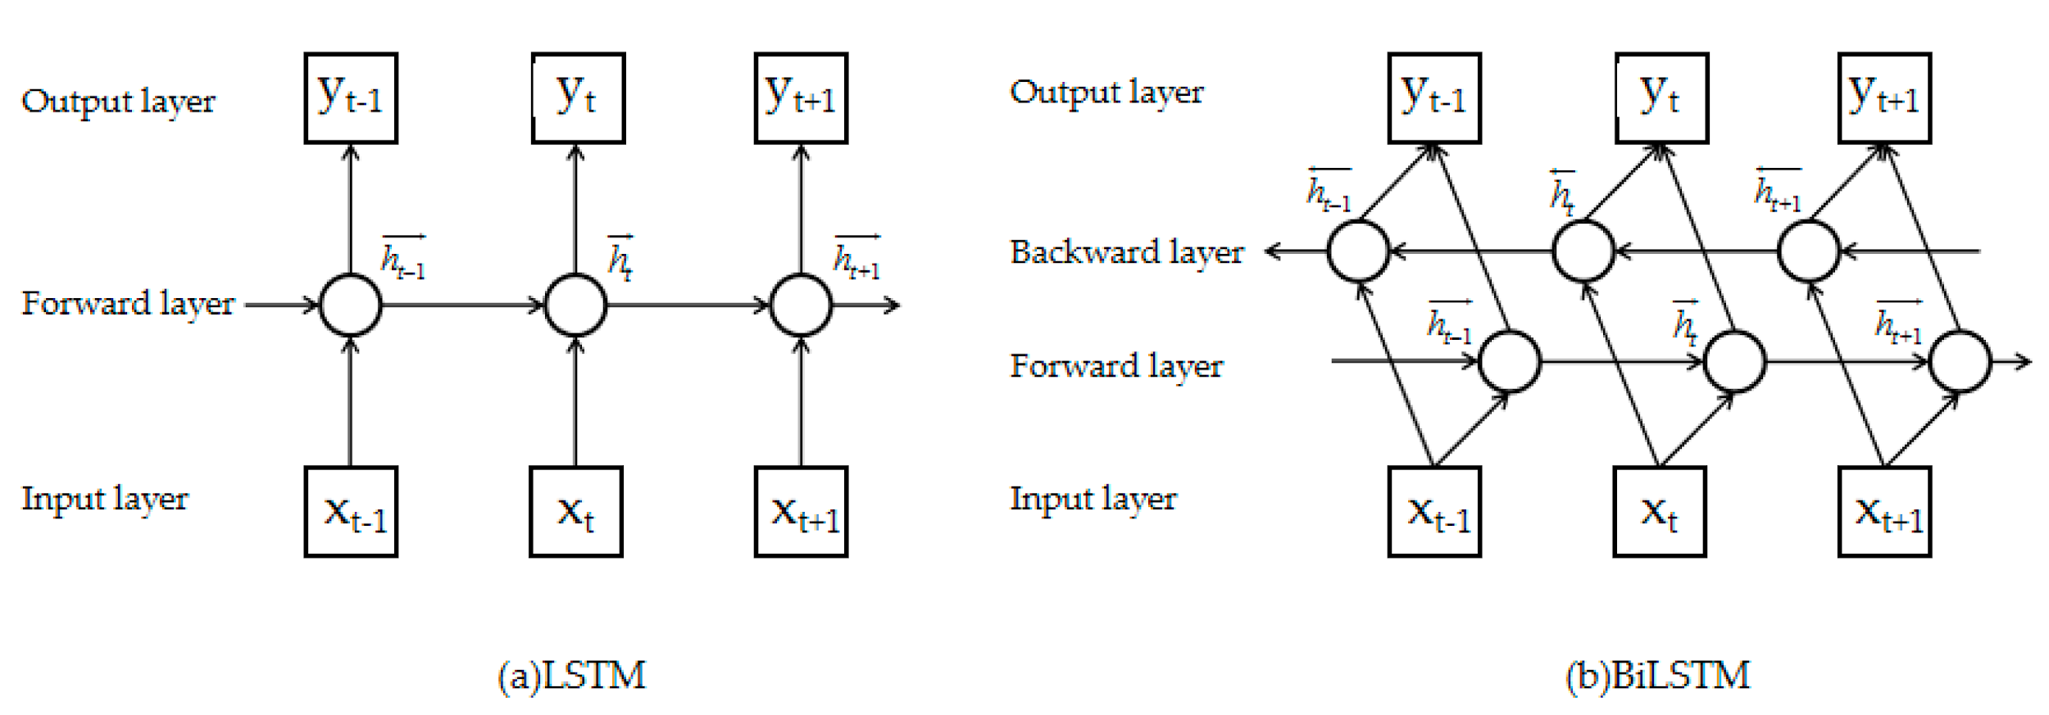
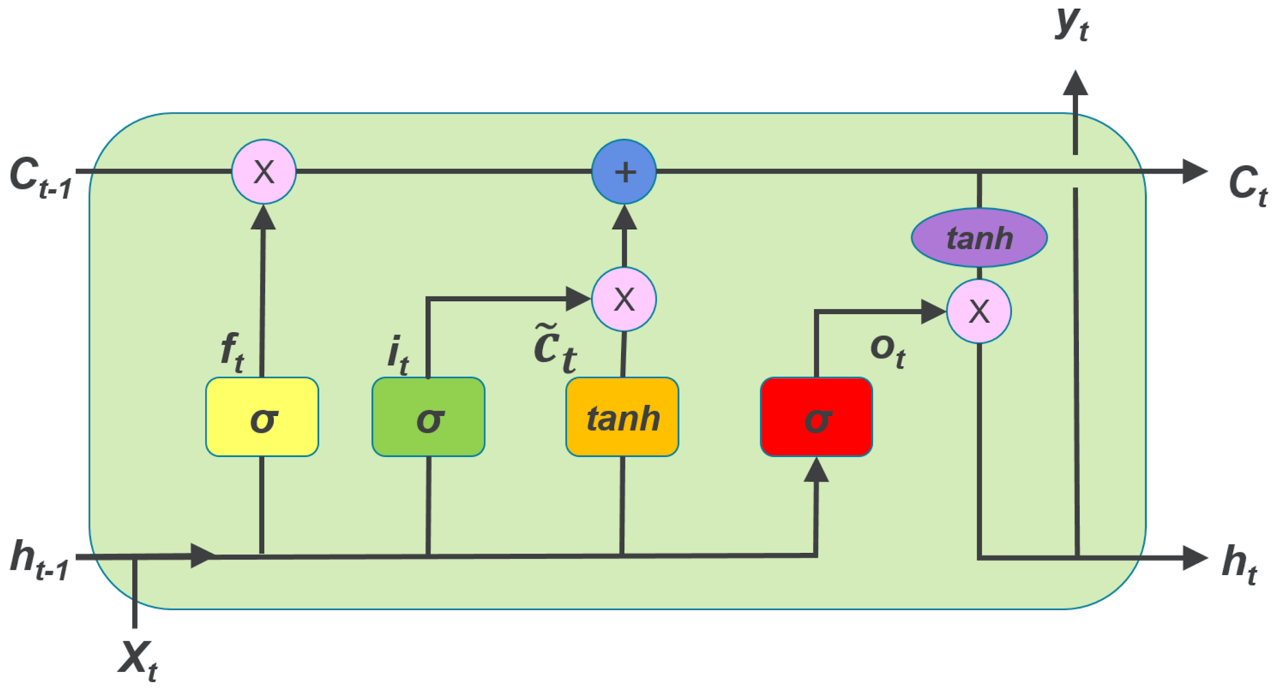
Long short-term memory (LSTM)
LSTM cell

Slide 10
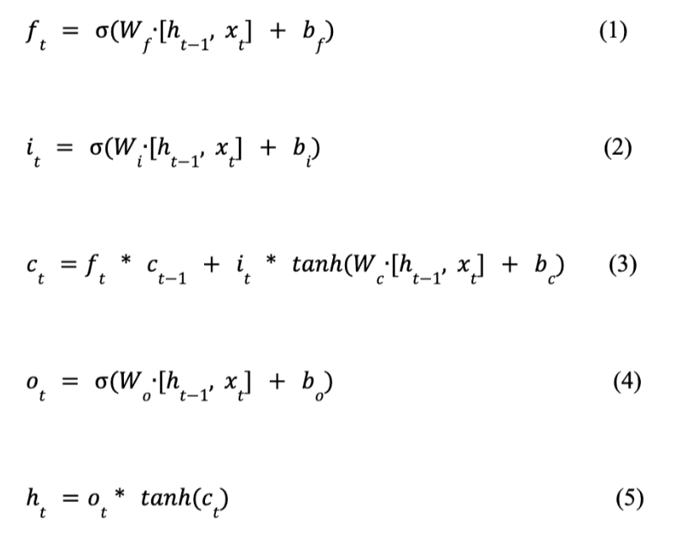
LSTM

Slide 11
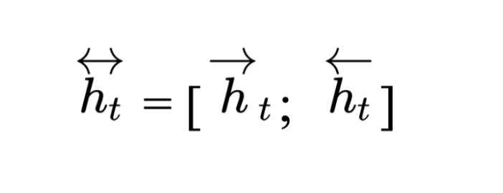
Bi-LSTM
→ Calculate input via 2 directions (forward and backward) in 2 separated LSTM layers

Slide 12
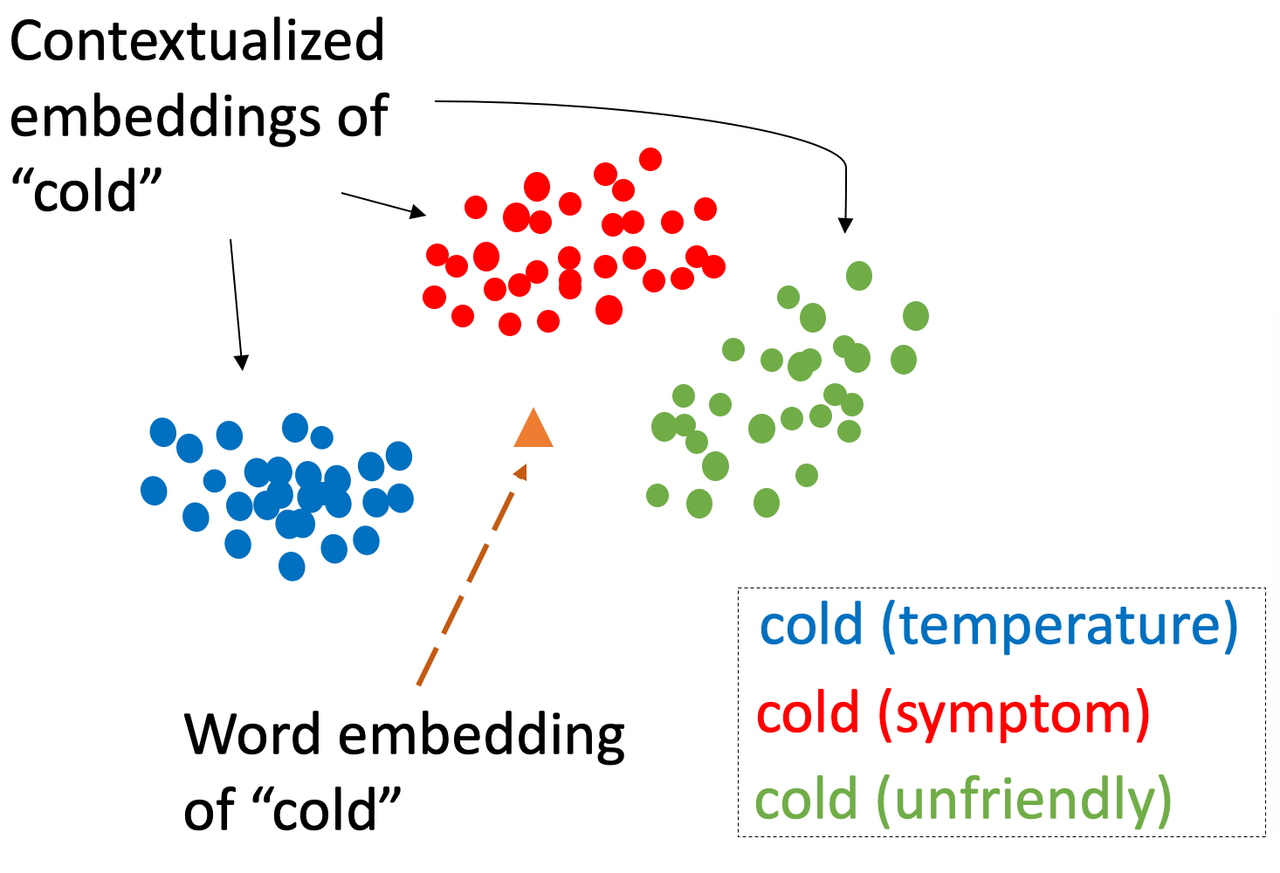
Word representation
Word Embedding (Word2Vec, Glove)
Contextual Embedding (ELMo, BERT, GPT-2)
⇒ Context based presentation

Slide 13
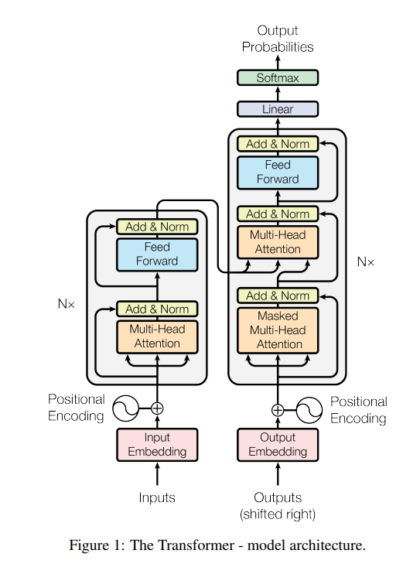
Transformers
Embedding
Positional Encoding
Self Attention - Multi-Head Attention
Feed Forward
https://jalammar.github.io/illustrated-transformer/

Slide 14
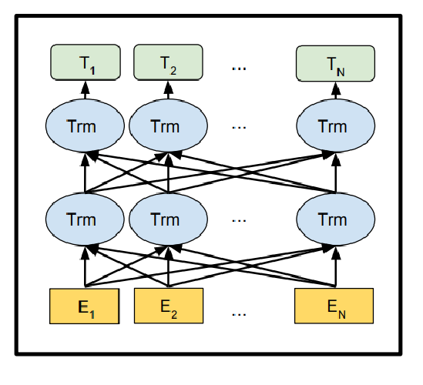
BERT
BERT makes use of Transformer, an attention mechanism that learns contextual relations between words (or sub-words) in a text
Fine-tuning BERT → Feeding output vector to classification layer
BERT architecture
https://towardsdatascience.com/bert-explained-state-of-the-art-language-model-for-nlp-f8b21a9b6270
Notes:
Classification tasks such as sentiment analysis are done similarly to Next Sentence classification, by adding a classification layer on top of the Transformer output for the [CLS] token.
In Question Answering tasks (e.g. SQuAD v1.1), the software receives a question regarding a text sequence and is required to mark the answer in the sequence. Using BERT, a Q&A model can be trained by learning two extra vectors that mark the beginning and the end of the answer.
In Named Entity Recognition (NER), the software receives a text sequence and is required to mark the various types of entities (Person, Organization, Date, etc) that appear in the text. Using BERT, a NER model can be trained by feeding the output vector of each token into a classification layer that predicts the NER label.

Slide 15
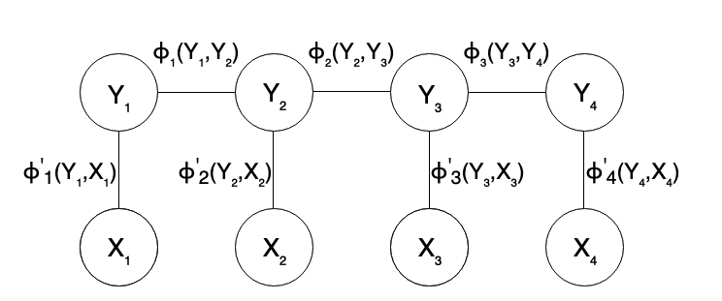
Conditional Random Fields
Notes:
In the CRF, the input data is sequential, so that the previous context must be considered before making a prediction on a data point, thereby increasing the accuracy of the model. For example, if the previous label is B-P (begin phrase) then the following tag is most likely I-P.

Slide 16
Keyphrase extraction
3

Slide 17
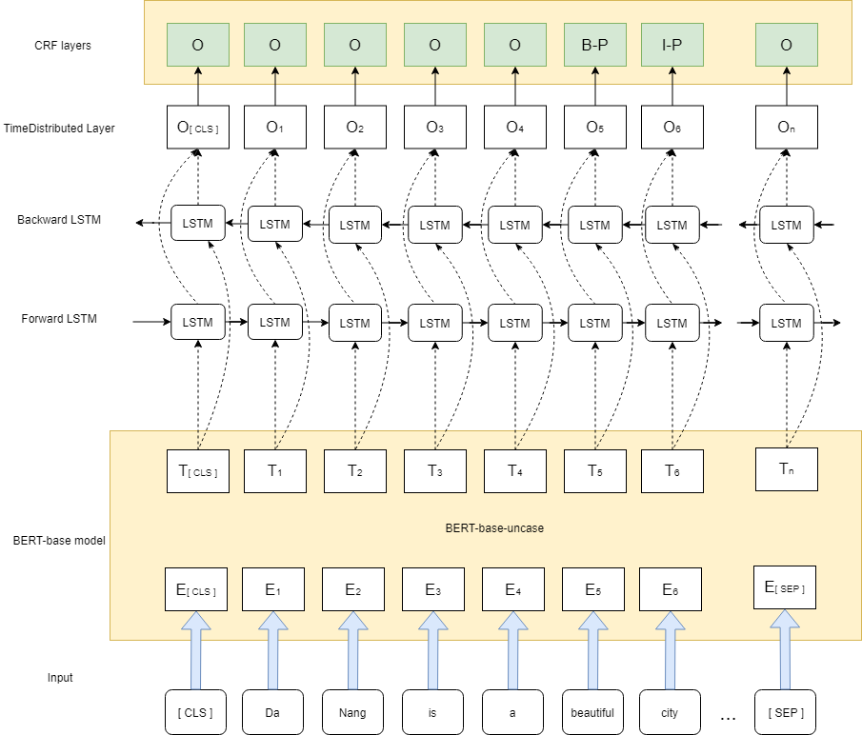
The model

Slide 18
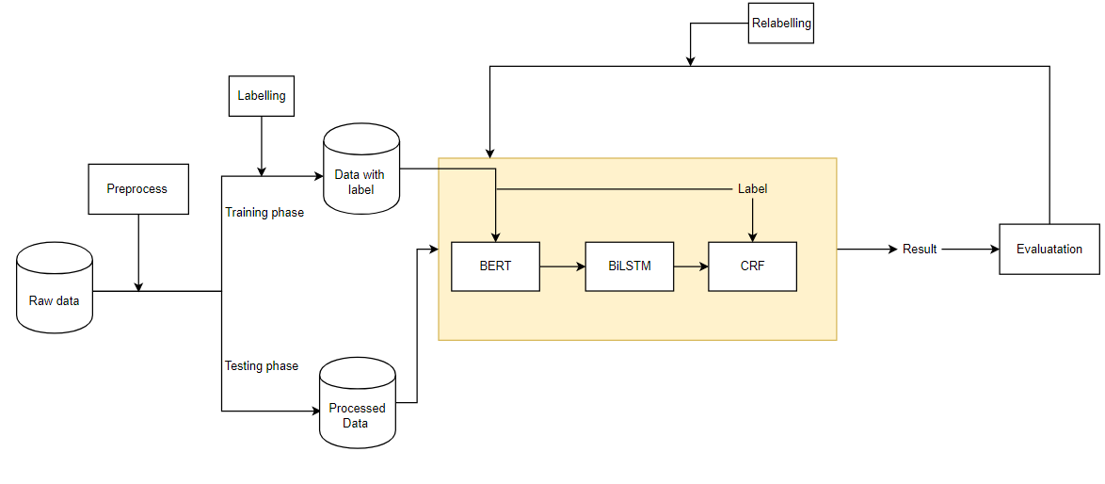
Pipeline

Slide 19
Result
4

Slide 20
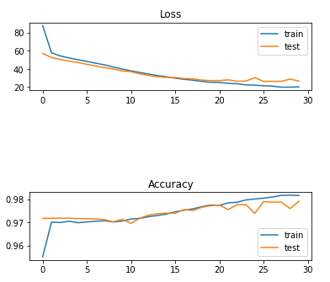
Evaluation

Slide 21
Evaluation (Data train)
 | Precision | Recall | F1 | Exact match
BERT Embedding | 0.954 | 0.891 | 0.921 | 0.282
Glove Embedding | 0.956 | 0.724 | 0.824 | 0.211
https://www.statology.org/f1-score-vs-accuracy/

Slide 22
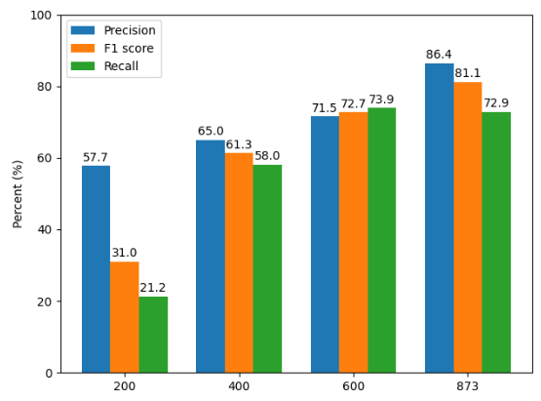
Evaluation (Data test)

Slide 23
Example result
 | Result
SGrank | Danang is a developing coastal city in the central part of Vietnam and is known as one of the largest cities alongside Hanoi and Ho Chi Minh city. Visiting Da Nang, you will be astounded by the amazing natural landscape, the friendly locals and a countless number of great attractions around the city.
BERT-BiLSTM-CRF | Danang is a developing coastal city in the central part of Vietnam and is known as one of the largest cities alongside Hanoi and Ho Chi Minh city. Visiting Da Nang, you will be astounded by the amazing natural landscape, the friendly locals and a countless number of great attractions around the city.

Slide 24
Conclusion
Apply Contextual Embedding to keyphrase extraction problem
Closed domain
Define training pipeline

Slide 25
THANKS!

Slide 26
References
A Review of Keyphrase Extraction (2019)
(https://arxiv.org/pdf/1905.05044.pdf)
Textacy
(https://pypi.org/project/textacy/0.2.3/)
Transformers
(https://github.com/huggingface/transformers)
(https://huggingface.co/)
(https://github.com/NielsRogge/Transformers-Tutorials)

